Slide 1
Programme
What?: clarification
Why?: Need for trust, reasons for trustworthiness
How?: Trust and control, social psychology

Slide 2
What: Clarification
Still confusion about what trust means
Trust → giving room for conduct → risk/uncertainty; Without risk no relationship., Risk of (onesided) dependence
Trust not blind: adjust room according to outcomes; trust and control can replace and supplement each other. Trust as the default.
Trust is to be earned by trustworthiness, reducing risk. There is much talk about trust where it should be about trustworthiness

Slide 3
Levels of trust
Individual (banker)
Organization (bank)
Surrounding institutions (financial markets)
Regulation, national & EU
Caught in prisoners’ dilemma’s → system tragedy
A course in ethics effective only if outside conditions enable/stimulate trustworthy conduct.

Slide 4
Competence and intention
Trust pricks up its ears when expectations not satisfied → what is going wrong?
Competence: technical ability to satisfy expectations
Intention: commitmemt to act to the best of one’s competence

Slide 5
Why: Has trust declined?
Trustworthiness has declined
Or:
We avoid risk more

Slide 6
Why: Philosophical background: Self and other
Self needs other not only for economic reasons (division of labour) but also for personal reasons of development
To reduce prejudice you need opposition from the other; To get beyond your own ideas you need ideas from the other.
Not just opening the door of your house to let the other in, but let the other help build your house.
Not ‘what do I expect from the other’ but ‘what can the other contribute’.

Slide 7
Risk and uncertainty
Risk: you do not know what will happen, but you do know what can happen → attach probabilities and calculate optimal choice (e.g. highest expected return)
Uncertainty: you do not know what can happen, you cannot forecast → use scenario’s, not optimality but robustness, resilience, flexibility, courage to be vulnerable

Slide 8
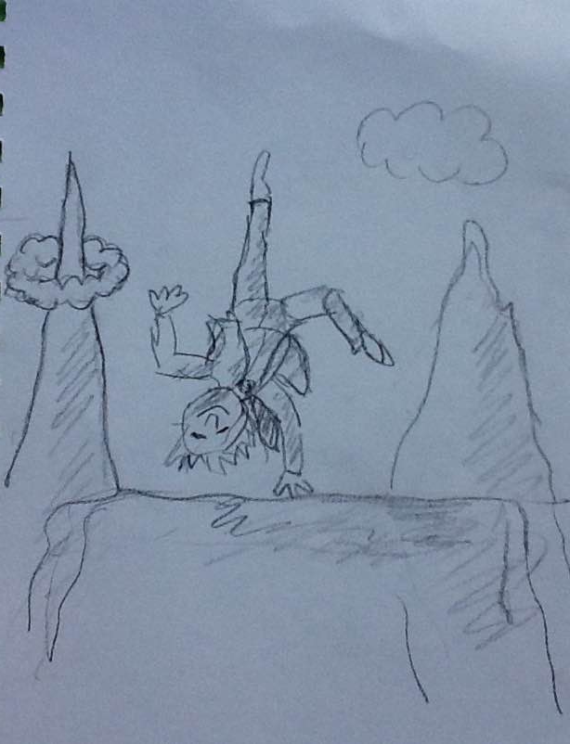
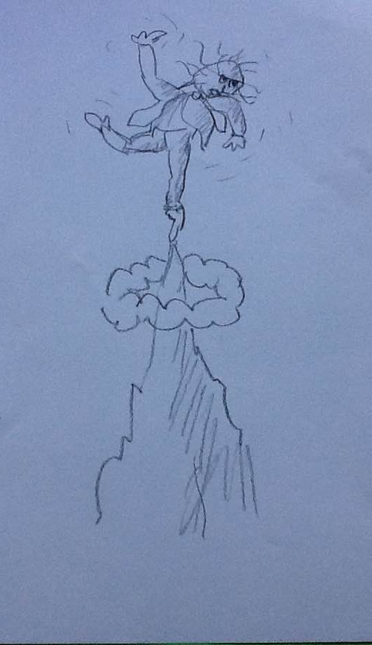

Slide 9
Trust and uncertainty
According to economics:
If trust does not go beyond enlightened but calculative selfinterest it does not mean anything
but then it cannot survive under competition in markets
According to me:
- The most valuable relationships are uncertain, as in innovation
→ even in the economy you cannot survive if you do not trust

Slide 10
How: Trust and reliance
Reliance: dependent on other but expectation that ‘things will be all right’, for whatever reason, including contractual or hierarchical enforcement.
Trust: even if the other has both the opportunity and incentive to cheat → on what basis?

Slide 11
Sources of reliance: trust and control
environment relation
Control actions
room contract hierarchy
incentives reputation dependence
hostage
Trust/altruïsm norms routine, empathy
values identification
Trust beyond calculative self-interest

Slide 12
Sources of reliance: trust and control
environment relation
Control actions
room contract hierarchy
incentives reputation dependence
hostage
Trust/altruïsm norms routine, empathy
values identification
Japan → Ukraine?

Slide 13
Exit and voice
Hirschman
Exit: when not satisfied, fire, sell, end contract
Voice: announce dissatisfaction, ask for explanation, seek solution
Behind voice lurks exit

Slide 14
Openness
Causal ambiguity: what went wrong: accident, lack of competence, lack of attention/commitment, or cheating?
→ need for openness: report errors, propose remedies, give benefit of the doubt
That is voice

Slide 15
Mental frames
Frames that yield interpretation and trigger action
Solidarity frame: trust, give and take, openness, voice
Defensive/survival frame: mistrust, guard your resources
Instinctively, people have both
Danger of frame switching → enact your trust and trustworthiness
Relational signalling

Slide 16
Trustbuilding actions
Don’t promise more than you can realise
Practise openness (see before)
Be open about expectations
Demonstrate loyalty

Slide 17
Horizontal control
Vertical control odd in times of professionalization and specialization
Literature on ‘Communities of Practice’: professional practice too rich (context dependent) and variable (development, innovation) to be caught in fixed protocols
→ Horizontal control:
A controls B: A asks B how it is best to be controlled: aim of both to minimize control, for efficiency, room for innovation, taking own responsibility, autonomy
Negotiation → agreement on procedure, external and internal
In case of cheating → return to old top-down extensive control

Slide 18
Advantages
Efficiency
Effectiveness
Learning system
Applied in Dutch tax system
Also being developed in health care, but only concerning financial control

Slide 19
Trust and art?
Trust needs opening up to the other, outside your thinking
Poetry is giving new, surprising meanings
→ Poetry helps trust

